Slide 1
Overview of Microcomputer
Structure and Operation
Course Teacher: Md. Motaharul Islam, PhD
Associate Professor Department of Computer Science & Engineering BRAC University.
Course ID: CSE - 341
Course Title: Microprocessors

Slide 2
Lecture References:
Book:
Microprocessors and Interfacing: Programming and Hardware, Author: Douglas V. Hall
Lecture Materials:
E4160: Introduction of Microprocessors.

Slide 3
Block Diagram of a Simple Microcomputer
Components of Microcomputer:
CPU
Memory
Input / Output circuitry
System Buses:
Address bus
Data bus
Control bus
Address bus
CPU
ROM
RAM
I/O
interface
I/O
devices
Data bus
Control bus

Slide 4
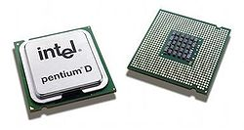
CPU - Central Processing Unit
It controls the operation of computer
The CPU fetches binary-coded instructions from memory
Decodes the instructions into a series of simple actions
Carries out these actions in a sequence of steps
Important components: IP (Instruction Pointer), General purpose registers and Control bus signal generating circuits
Pentium D dual core processors

Slide 5
Memory
It stores the binary codes for the sequence of instructions and binary coded data. Example: ROM, RAM and Magnetic disks
RAM can be read and written to anytime the CPU commands it, but ROM is pre-loaded with data and software that never changes, so the CPU can only read from it.
ROM is typically used to store the computer's initial start-up instructions.
In general, the contents of RAM are erased when the power to the computer is turned off, but ROM retains its data indefinitely.
In a PC, the ROM contains a specialized program called the BIOS that orchestrates loading the computer's operating system from the hard disk drive into RAM whenever the computer is turned on or reset.

Slide 6
I/O Unit
Input/output (I/O), refers to the communication between an information processing system (such as a computer), and the outside world possibly a human, or another information processing system.
Inputs are the signals or data received by the system, and outputs are the signals or data sent from it
Devices that provide input or output to the computer are called peripherals like the keyboard and mouse, and output devices such as the display and printer Hard disk drives, floppy disk drives and optical disc drives serve as both input and output devices.
Computer networking is another form of I/O.

Slide 7
System Bus
The microcomputer’s system bus contains three buses, address, data, and control bus
When a memory or an I/O chip receives data from the microprocessor, it is called a WRITE operation, and data is written into a selected memory location or an I/O port (register).
When a memory or an I/O chip sends data to the microprocessor, it is called a READ operation, and data is read from a selected memory location or an I/O port.

Slide 8
Address Bus
It is a Unidirectional bus.
Information transfer takes place from the MP to the memory or I/O elements.
Typically 16, 20, 24, 32 or 36 bits long.
On these lines the CPU sends out the address of the memory location or I/O port that is to be written to or read from
The number of locations that the CPU can address is determined by the number of address lines
For example : microprocessor with 32 address pins can
generate 2³² = 4,294,964,296 bytes

Slide 9
Data Bus
It is a bidirectional bus
Data can flow in both directions, that is, to or from the microprocessor.
The size of the data bus varies from one microprocessor to another.
Usually matches the word length of the microprocessor
Usually a multiple of 8
We talk of 4-bit (nibble), 8-bit, 16-bit , 32-bit and 64-bit processors which refers to the normal word length of the microprocessor

Slide 10
Control Bus
It consists of a number of signals that are used to synchronize operation of the individual microcomputer elements.
Consists of potentially many signals. Typically:-
Read
Write
Could be single signal - Read/notWrite line
Interrupt control
Bus control signals for DMA (Direct Memory Access)

Slide 11
Fetching & Execution Cycles
Fetching Cycles
The fetch cycle takes the instruction required from memory, stores it in the instruction register, and
moves the program counter on one so that it points to the next instruction.
Execute cycle
The actual actions which occur during the execute cycle of an instruction.
depend on both the instruction itself and the addressing mode specified to be used to access the data that may be required.

Slide 12
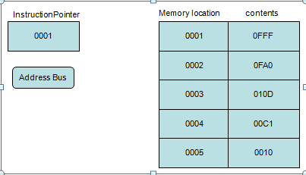
Fetching an Instruction
Step 1
Instruction Pointer (IP) or a program counter is register, that holds the address of the next instruction to be fetched.

Slide 13
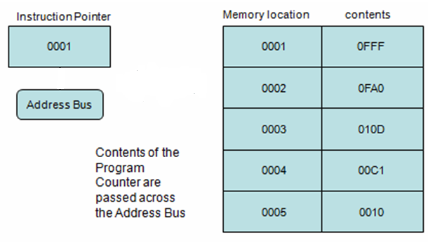
Fetching an Instruction
Step 2

Slide 14
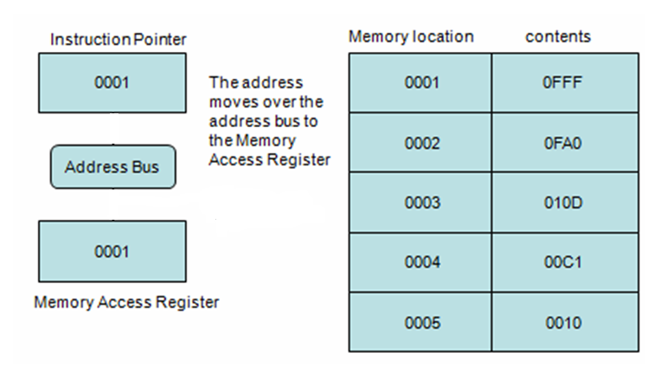
Fetching an Instruction
Step 3

Slide 15
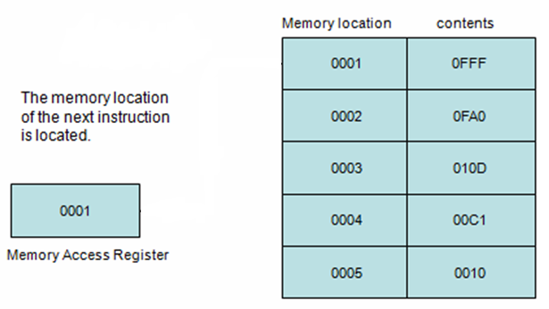
Fetching an Instruction
Step 4

Slide 16
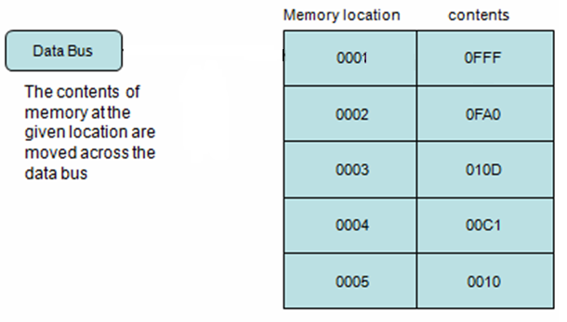
Fetching an Instruction
Step 5

Slide 17
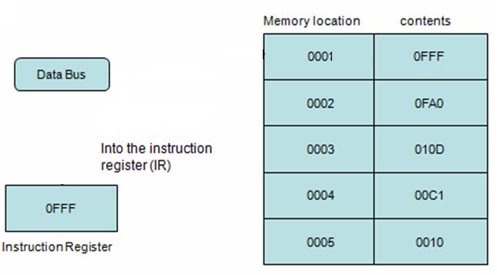
Fetching an Instruction
Step 6

Slide 18
Thank You !!

